Slide 1
Music Recommender
By, Jacob Kurstedt

Slide 2
Problem
Wanted to be able to get song recommendations for songs that I enjoy

Slide 3
Data Wrangling
Used a Kaggle Data set with over 150 thousands songs in it
Had to strip unnecessary characters in the artists column
Merged the genre of each song onto my existing dataframe
Changed the Key column from numeric to actual key values (c, c#,…)
Made the name of the songs lower case
Dropped duplicate songs

Slide 4
Exploratory Data Analysis
Looked at different metrics based off if the song grouping by if the song was minor or major and explicit or not
Songs that were explicit seemed to have a lot higher danceability and were more popular overall
Energy and loudness had the best correlation when it came to the popularity of the song while acousticness and instrumentalness had the worst
Danceability and energy had the best correlation to the valence (the positivity of the song)

Slide 5
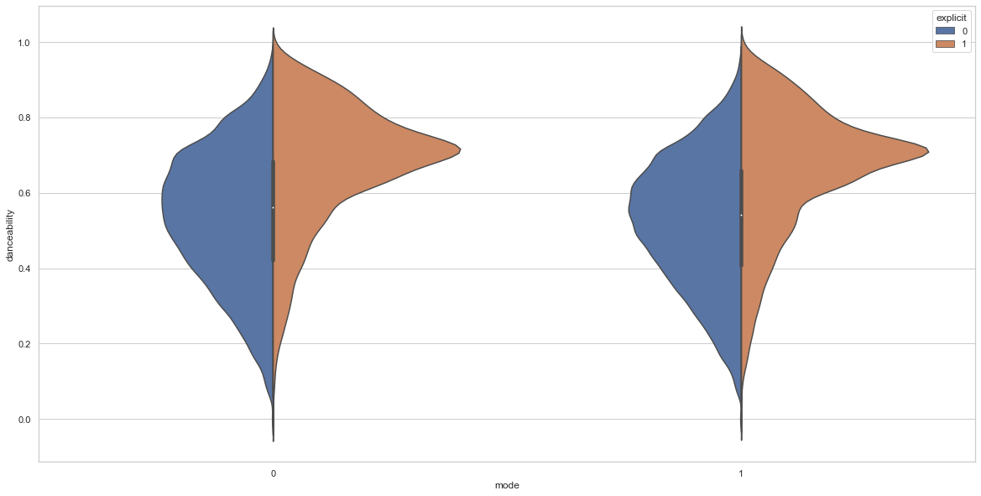
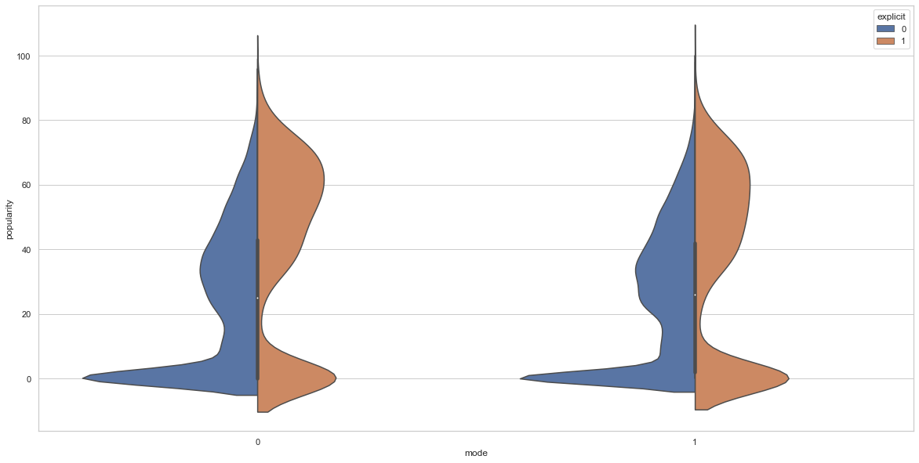
Exploratory Data Analysis
Danceability
Popularity

Slide 6
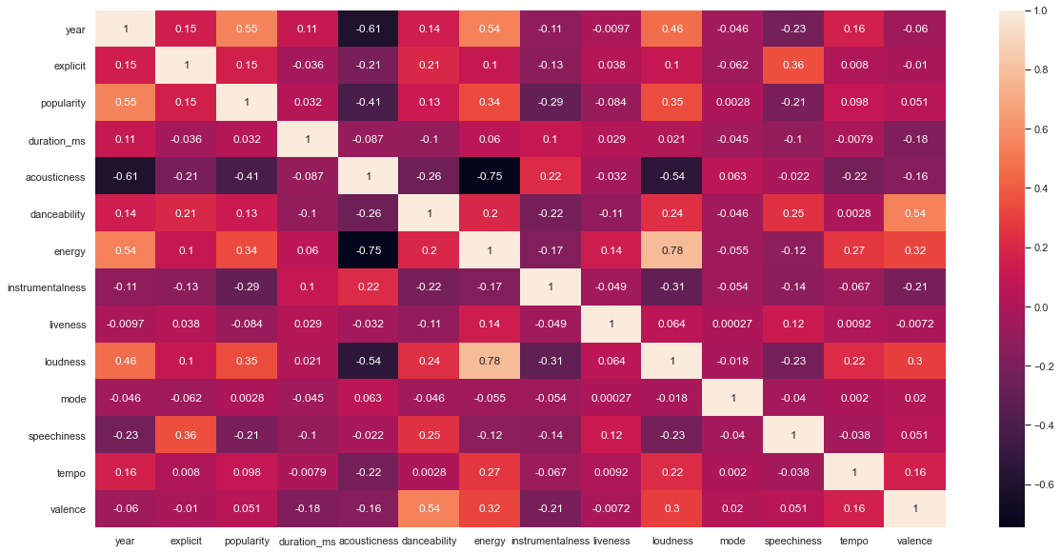
Exploratory Data Analysis

Slide 7
Preprocessing
Had to change the metric values from float64 to float32 in order to save memory
Scaled the metrics using a MinMaxScaler
Preformed Cosine Similarity, Euclidean distance and Pearson Correlation
Although they all preformed well and recommended similar songs Cosine similarity is what I choose to use when finalizing the recommender

Slide 8
Preprocessing
Using the Cosine Similarity recommender I created a Data Frame that had the id, name, artists, and a dictionary with the top 5 recommended songs
I did this to minimize the runtime when running the application

Slide 9
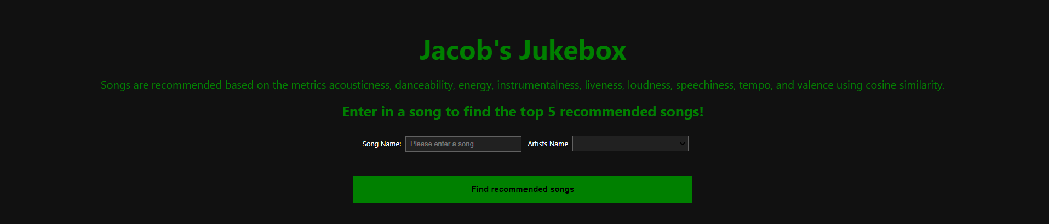
Modeling/Application
Using ipywidgets, voila, and Heroku I was able to deploy the music recommender.
https://jacobs-jukebox.herokuapp.com/

Slide 10
Conclusion
In conclusion using cosine similarity was the best choice when making the recommender I believe it recommended the best songs out of the 3 recommenders I tried
I am excited to continue building on the recommender and add more features and songs to it

Slide 11
Moving Forward
Continue to add songs to the dataset
Make it so people have the ability to create playlists based off the recommended songs
Create another button to recommend the next top 5 songs
Using less metrics when recommending a song
Adding in another drop down for people to be able to filter recommended songs by genre

